Slide 1
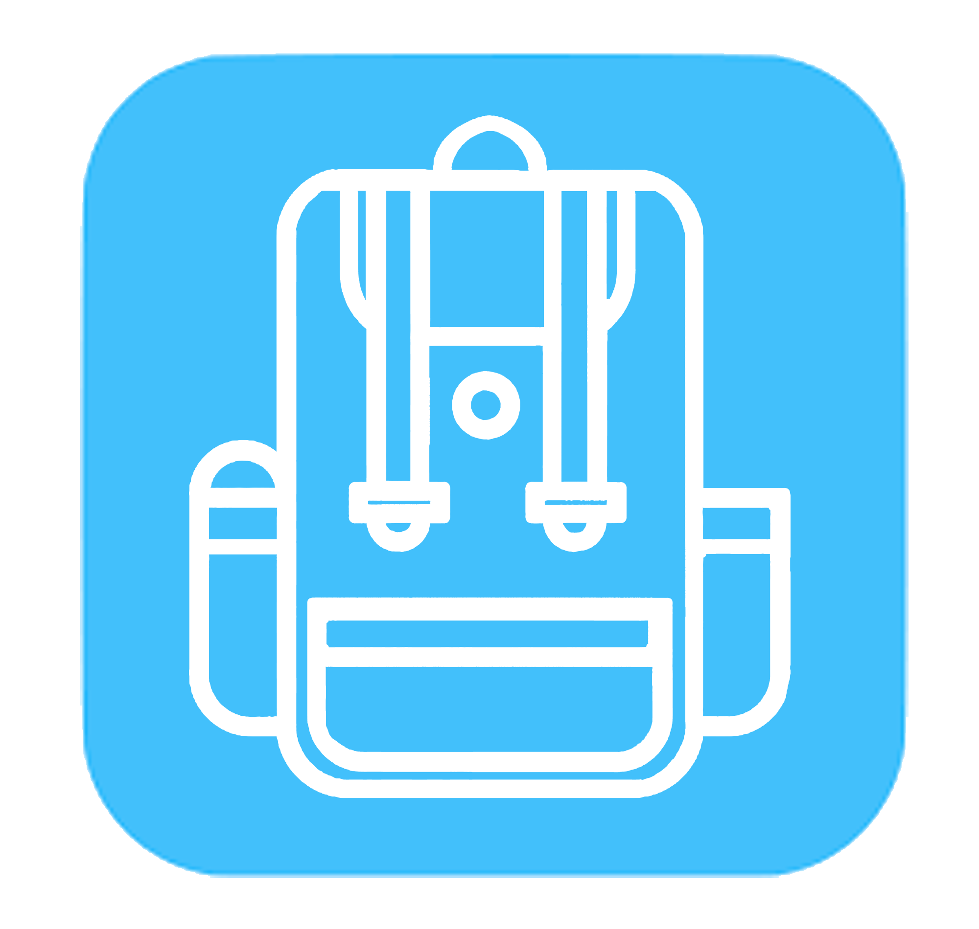
TrackPack
Keeping children safe
Notes:
Gps enabled device in a backpak

Slide 2
Peace of Mind
The TrackPack is a piece of safeguarding technology that is handy and convenient to use and is aimed at parents
Mission
Vision
What we are trying to achieve is a simple and straight forward device that can track a child's location for their safety, at the same time reassuring their parents.
Is to combat the amount of children that are abducted every year and ensure safety of minors
Goals
Values
If this product would be on the market, our goal would be to improve the owners safety and ensure their guardian knows where they are at all times.
This device is straight forward and easy to set up and use. By utilizing the long range, low power wireless communication features of the Explorer, making it ideal for this job.

Slide 3
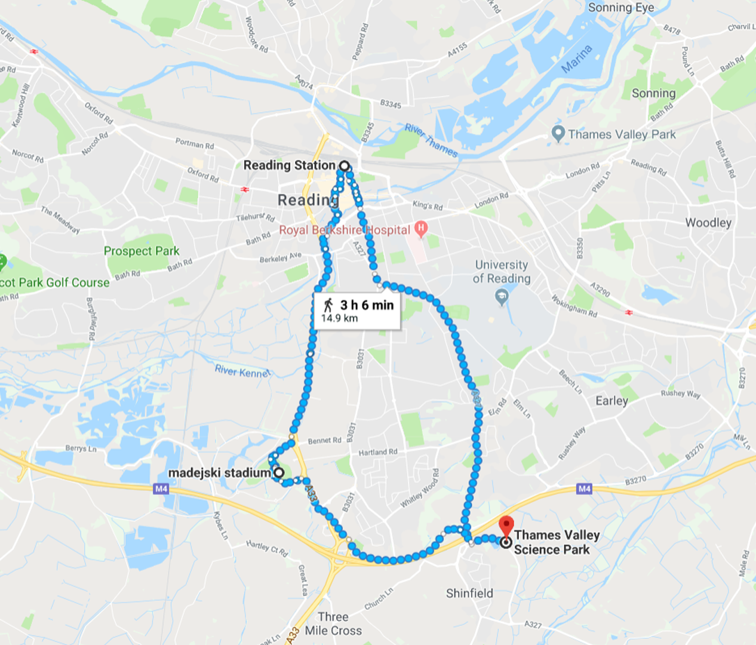
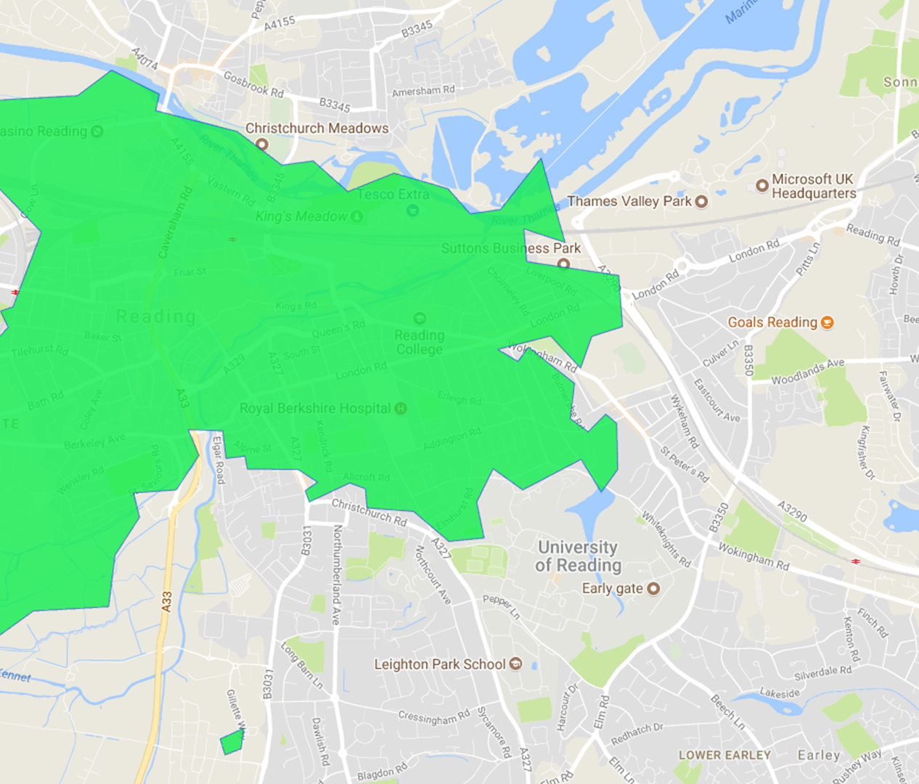
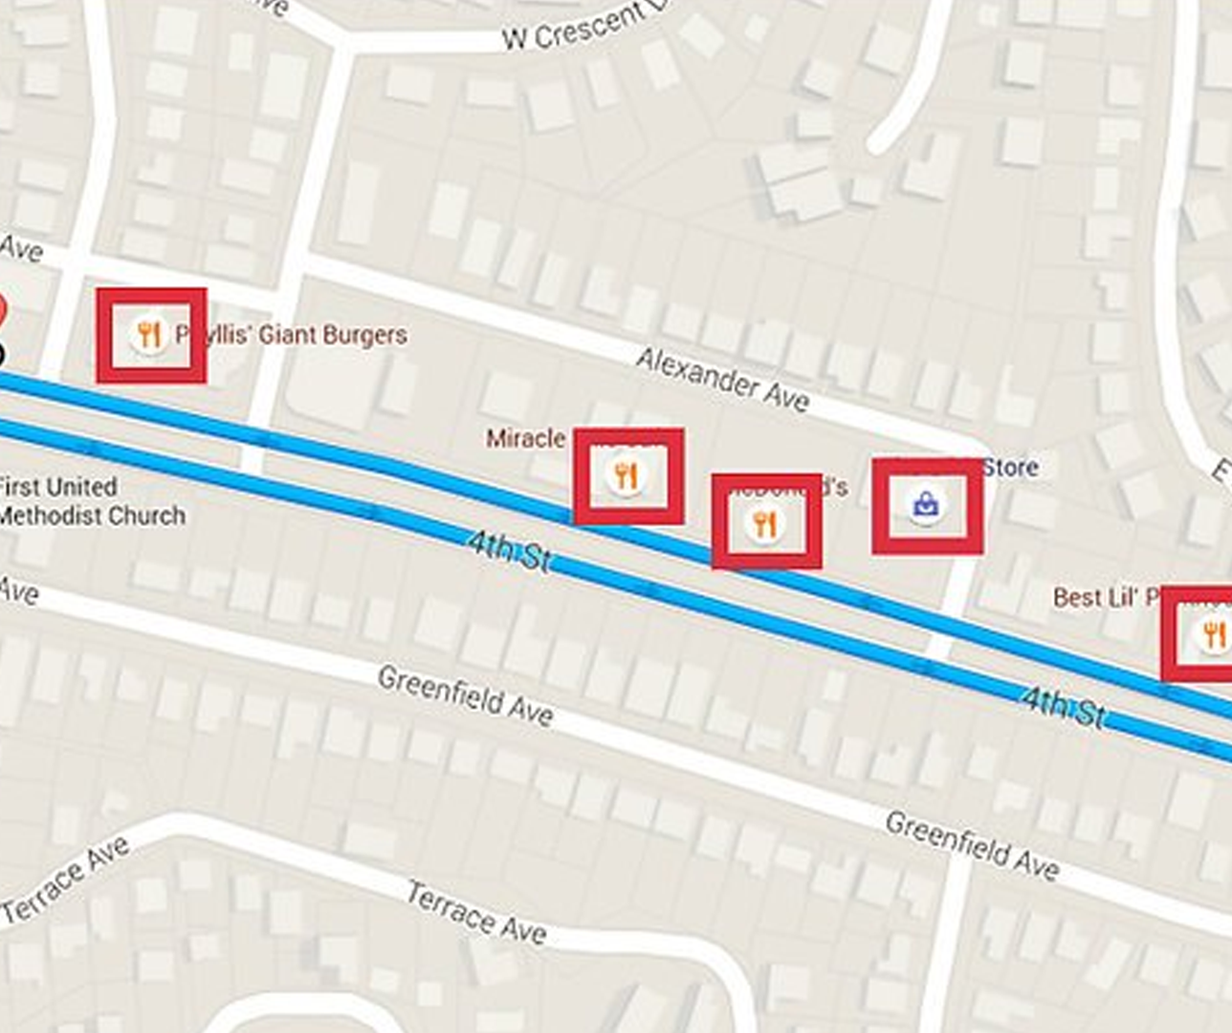
Reported to phone
On the guardian’s side they will be updated if the child is diverted from their usual route or is separated from their walking partner, a notification is sent to their phone to then alert them.
Location on map
The Explorer will ping the co-ordinates every 5 minutes mapping the route of the owner. Furthermore you can map out the usual routes you would take for example: Going to school or going to the shops.
Compared with crime stats
Once the server has received the GPS signal from the Board it will compare the location to the open source police crime data to see if their child has entered a area with an increased crime frequency.

Slide 4
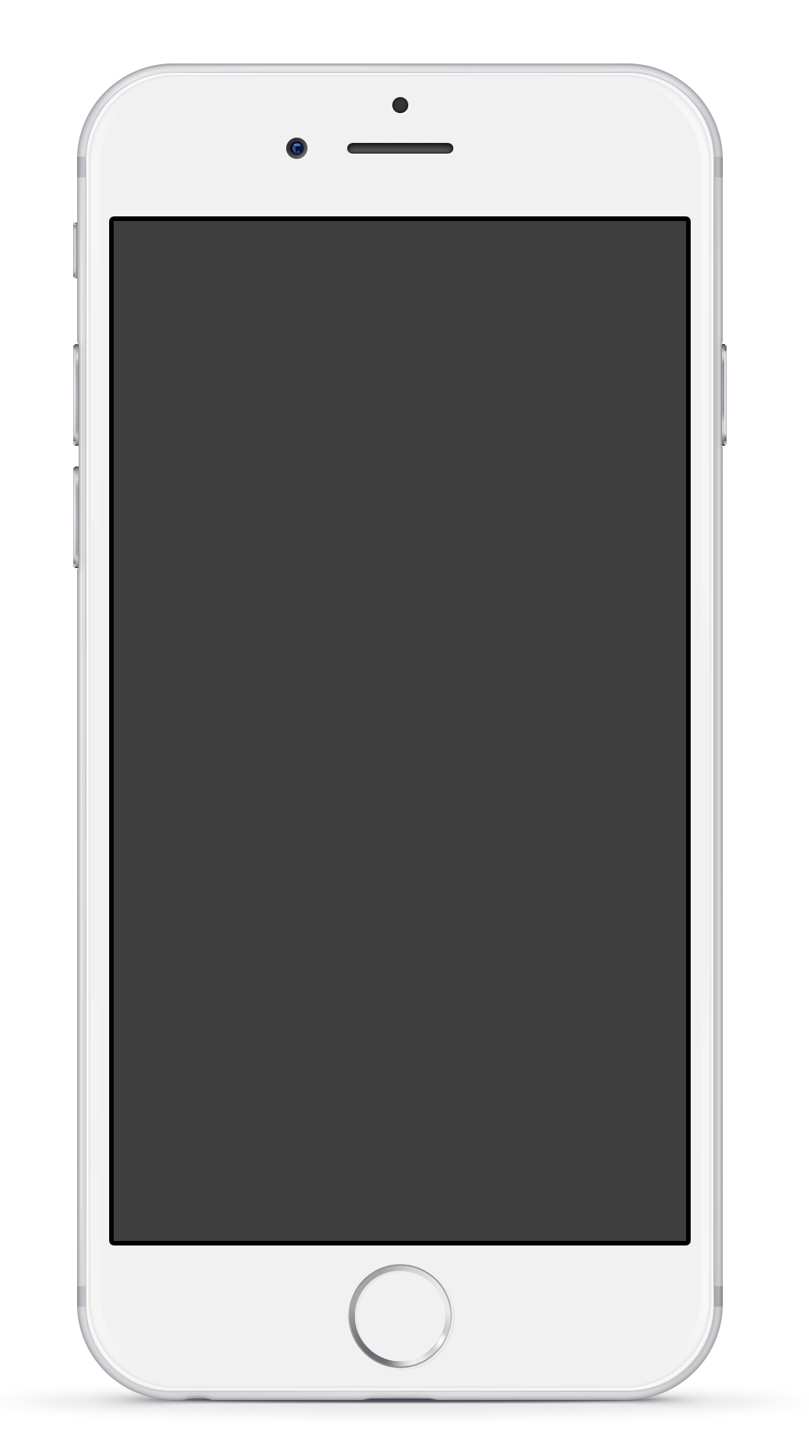
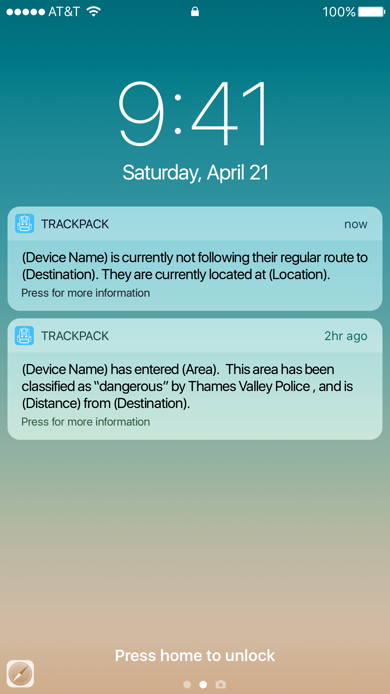
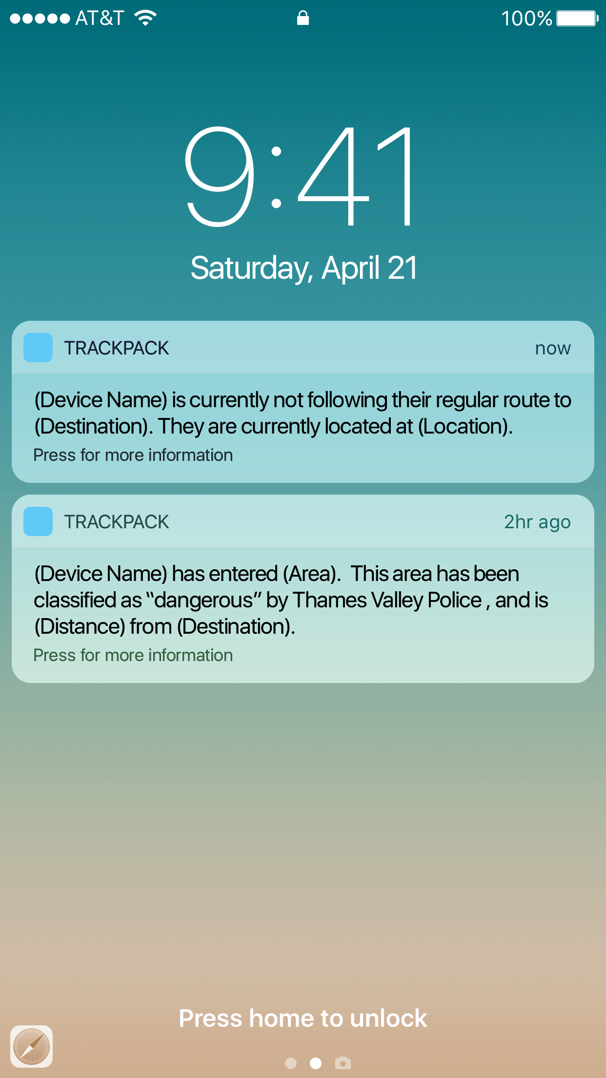
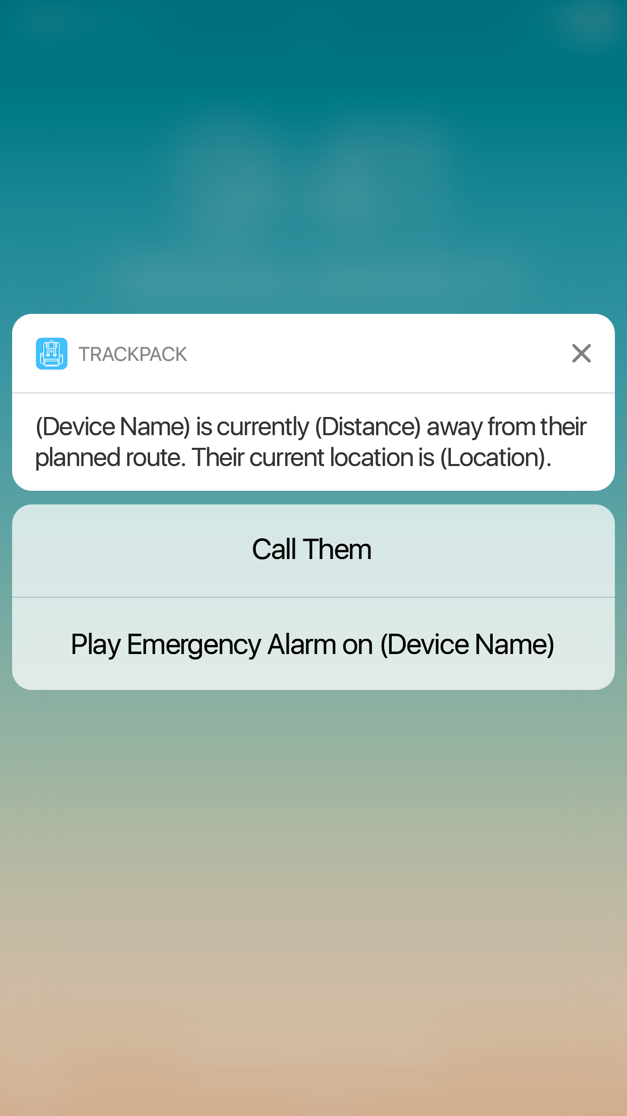
TrackPack notification system
Example of the notification
This is what the parent or guardian will see. It will show basic information on what the app has observed after is comparison between the location , normal paths and crime maps. It is secure fast and easy to understand meaning that any parent or guardian could use it with minimal effort.
Secure
Fast
Easy to understand

Slide 5
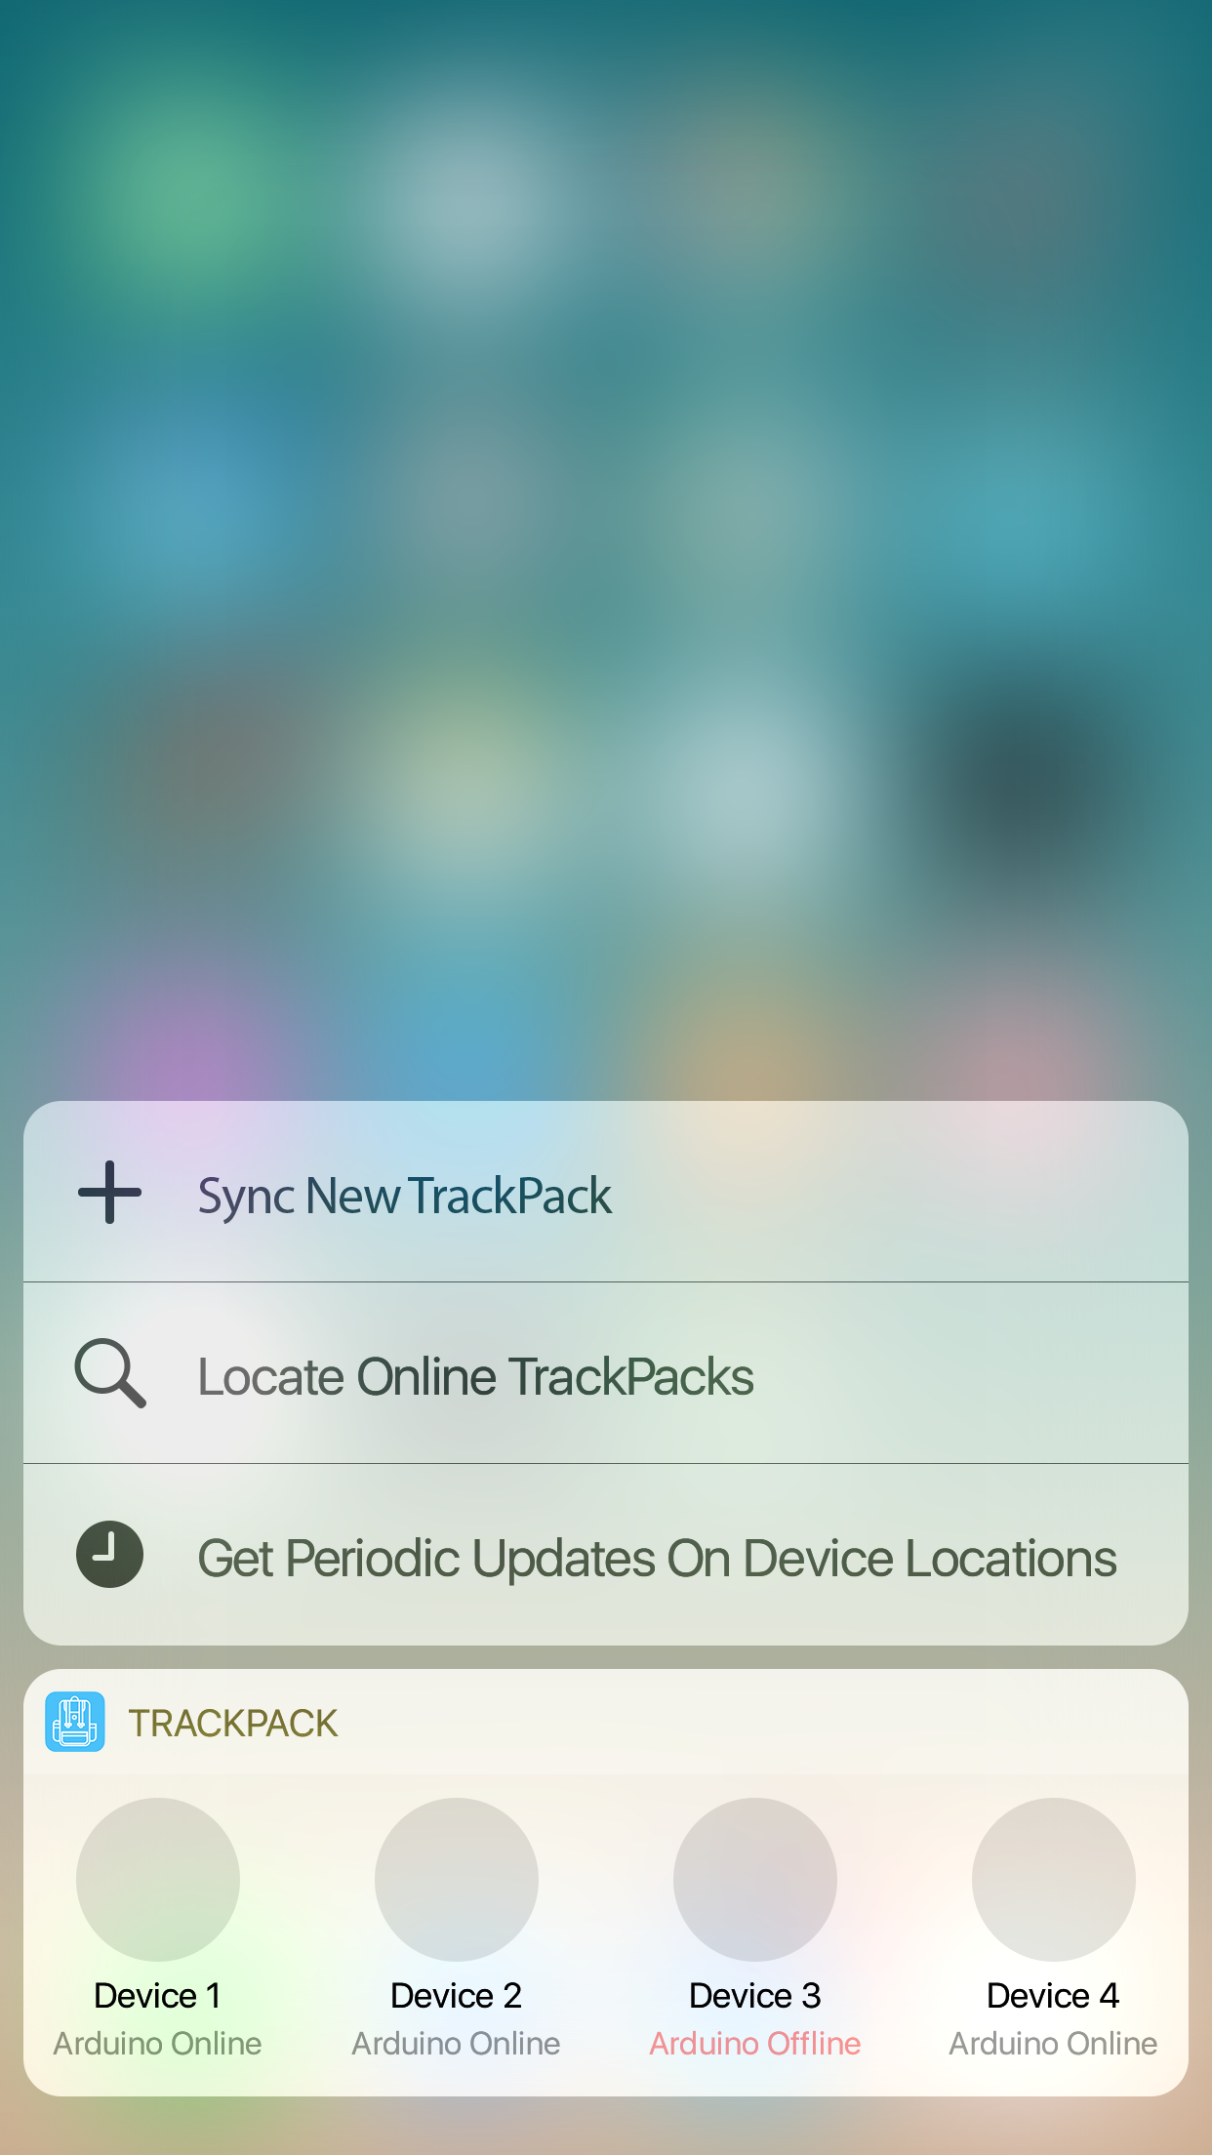
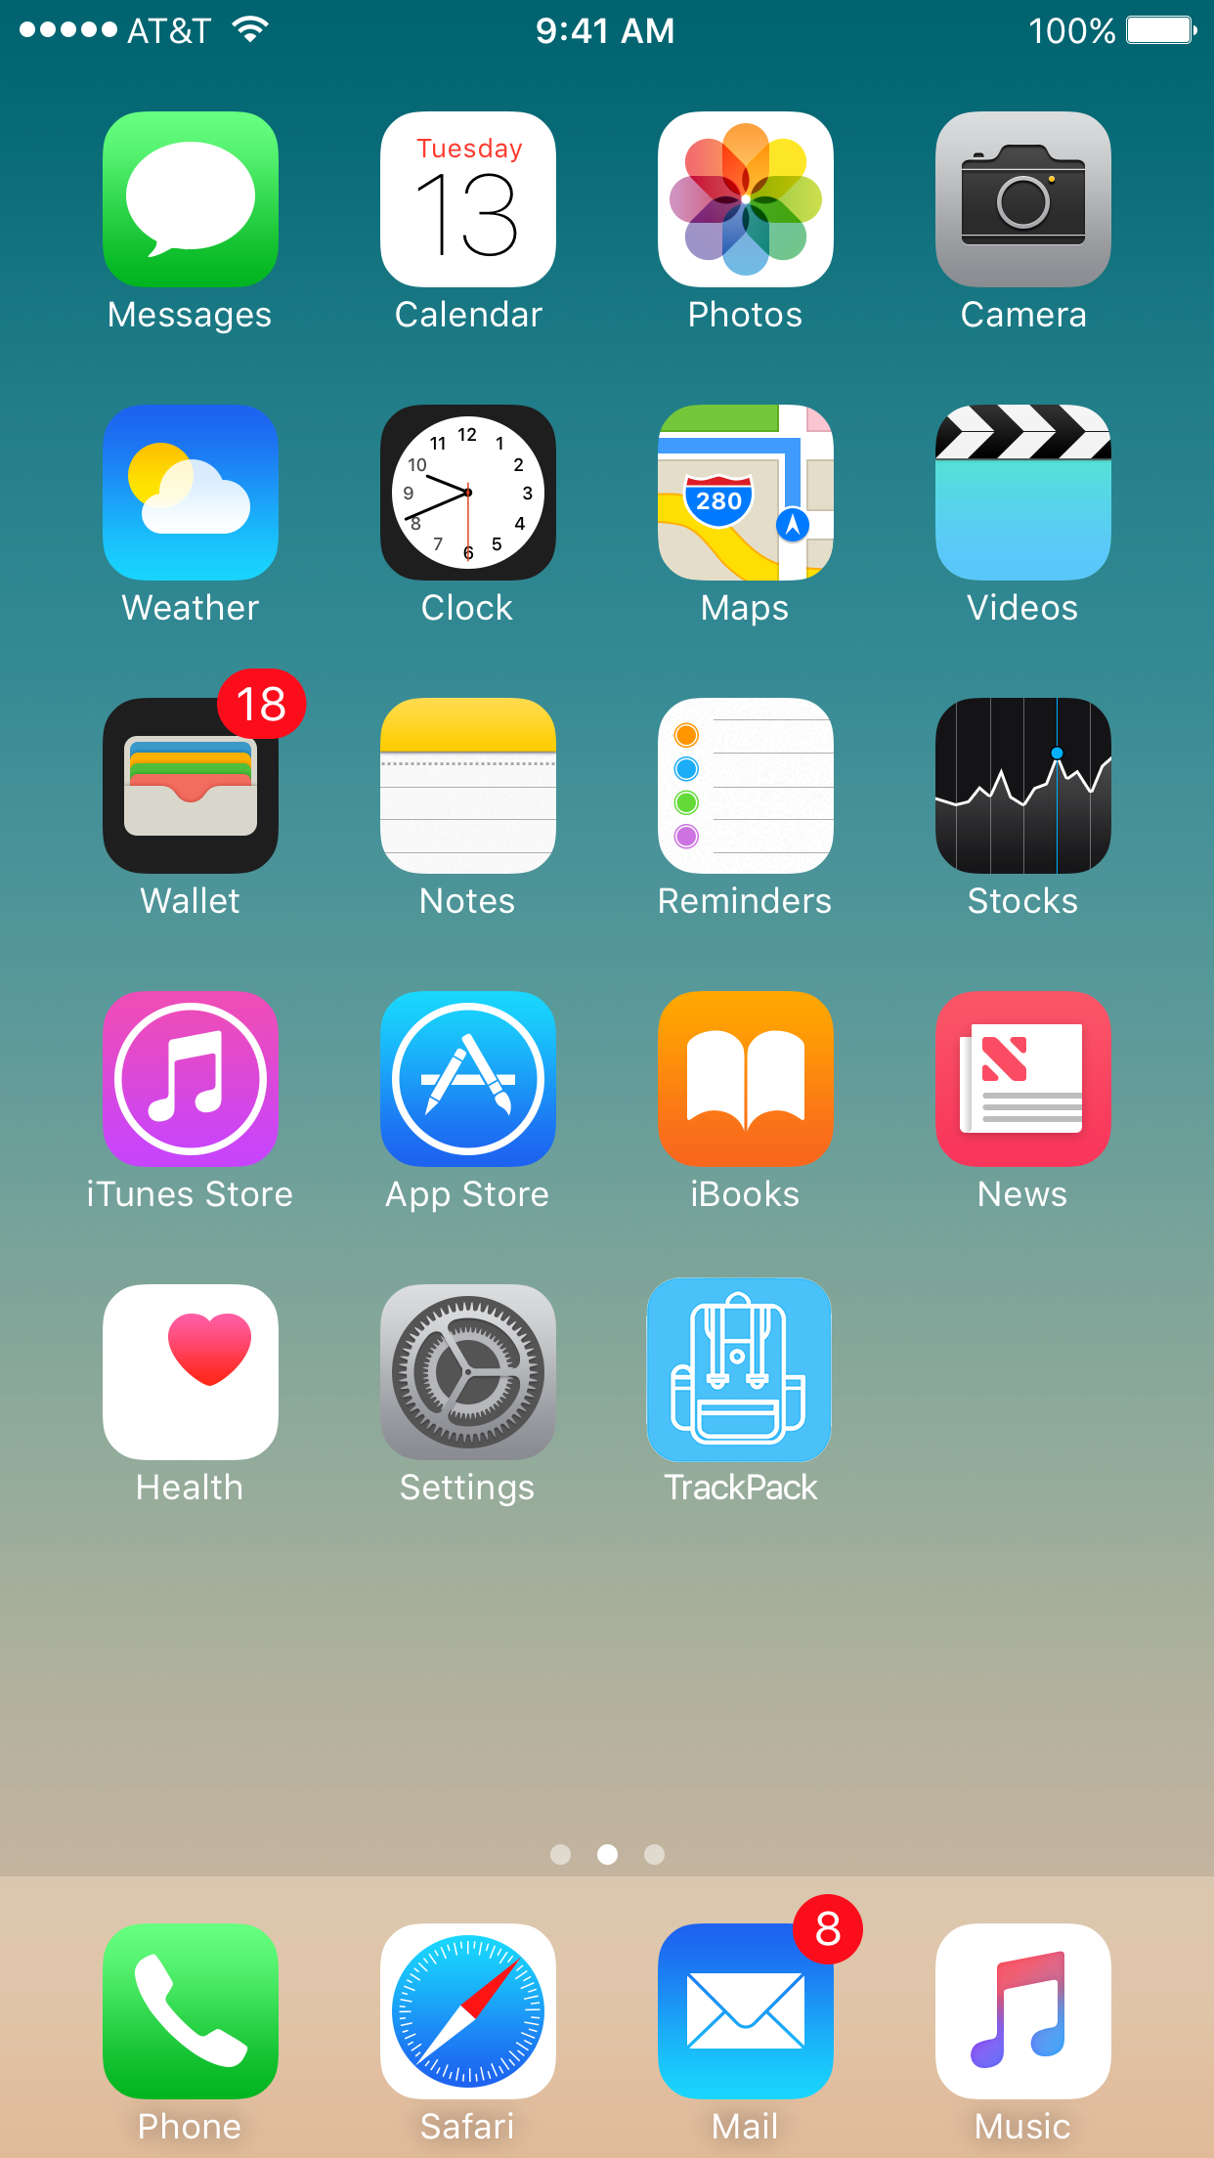
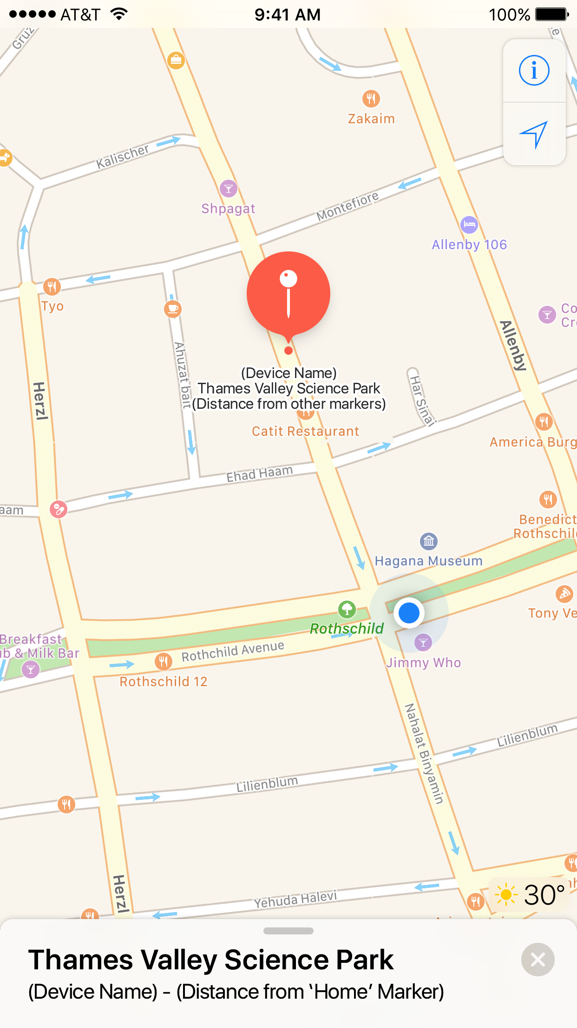
Full Mobile Functionality
Allows for both monitoring and notification.

Slide 6

Why LoraWan will work well
It will work well, mainly for the long range capability , so you can track the backpack from a far distance. As well the low power usage meaning that you don’t need to recharge it very often and it isn’t something that you need to worry about

